Slide 1

Design & Implementation of a Multi‑Model AI Agent for Automated Health Diagnostics
Intelligent interpretation of blood reports and personalized health recommendations
Presented by: SUBALAKSHMI SRIDHAR — February 2026

Slide 2

The Problem & Opportunity
Data-to-Insight Gap
Opportunity
Laboratory PDFs contain dense numeric results but lack immediate, actionable context for patients and clinicians.
Automate synthesis of raw results into plain‑language narratives, prioritized clinical actions, and longitudinal tracking.
Target Outcome
Transform extracted reports into a synthesized health narrative with a >95% workflow success rate.

Slide 3
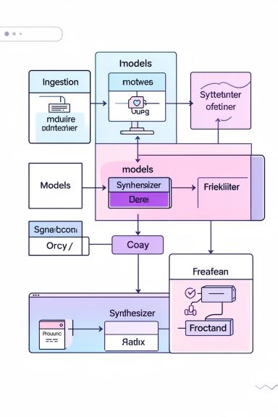
Project Architecture — The "Brain"
Decoupled, modular design for scalability, traceability, and clinical safety. Each stage is independently testable and auditable.
1
2
3
1. Data Ingestion
2. Multi‑Model Analysis
3. Synthesis & Delivery
Hybrid extraction (digital + OCR) normalizes diverse PDF formats into structured parameters.
Three independent models produce parameter interpretation, combined risk, and demographic context adjustment.
Recommendation generator turns model outputs into prioritized, traceable clinical guidance and patient‑friendly summaries.

Slide 4
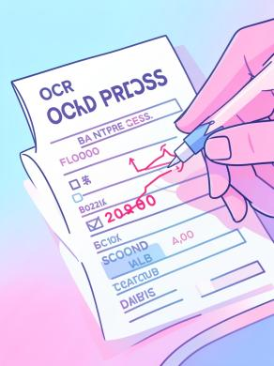
Milestone 1 — Data Extraction & Pipeline
Components: extractor.py (digital extraction), ocr_extractor.py (Tesseract fallback), cleaner.py (regex normalization).
Process Highlights:
Prefer direct text stream from digital PDFs; fallback to Tesseract for scanned images.
Regex and rule-based cleaning map messy strings to numeric parameters and units.
Structured output schema (label, value, unit, reference range, method tag) for downstream models.

Slide 5
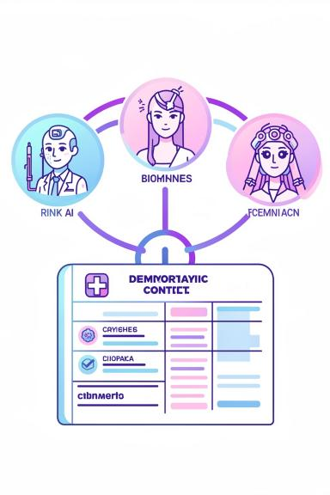

Milestone 2 — Multi‑Model Analysis Strategy
Model 1 — Parameter Interpreter
Classifies each lab value as LOW / NORMAL / HIGH with method confidence and provenance to the original cell.
Model 2 — Combined Risk Assessment
Aggregates patterns to estimate probabilities for conditions (cardiovascular, diabetes, anemia) and flags correlated abnormalities.
Model 3 — Contextual Adjuster
Applies age, sex, and clinical context to refine risk, reduce false positives, and tailor urgency levels.

Slide 6
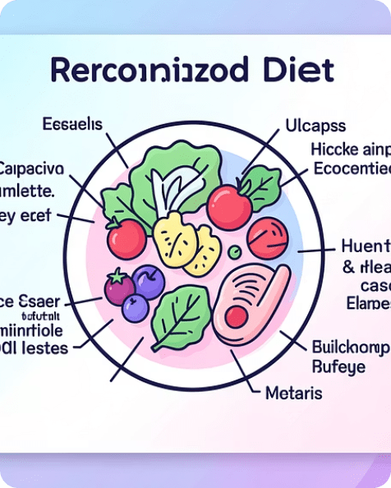

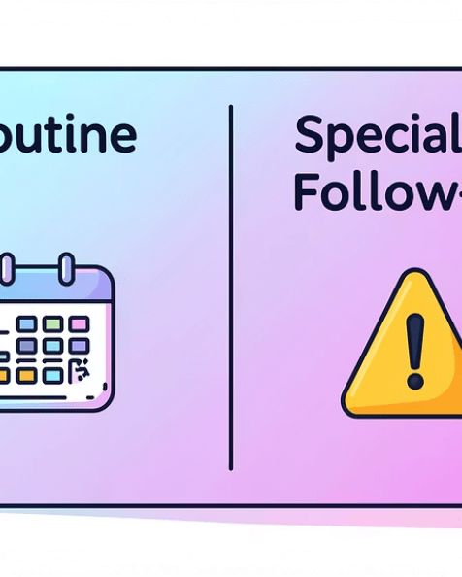
Milestone 3 — Synthesis & Actionable Insights
The synthesis engine consolidates model outputs into a coherent patient narrative and explicit, evidence‑linked recommendations.
Personalized Diet
Lifestyle & Exercise
Follow‑Up Triage
Targeted nutrition advice mapped directly to detected abnormalities (e.g., iron-rich foods for low hemoglobin).
Specific activity recommendations with frequency and clinical rationale (e.g., aerobic for dyslipidemia).
Clear urgency levels (Routine / Expedited / Specialist) with rationale and linked lab evidence for clinician review.

Slide 7
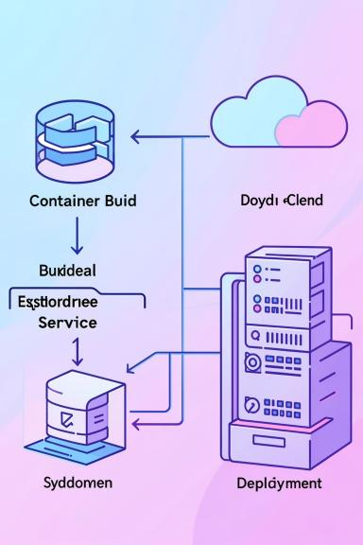
Milestone 4 — Integration & Deployment
End‑to‑End Workflow: Multi‑Model Orchestrator manages state across ingestion, analysis, and synthesis layers.
Deployment:
Dockerized services for consistent cloud deployment.
Systemd service templates for production Linux hosts and scheduled batch processing.
Configurable Streamlit frontend for interactive clinician review and patient views.
Outputs: Text, HTML, JSON, Markdown — each includes provenance metadata for audit.
Validation: Integration tests (test_milestone3.py) achieved 100% pass on controlled datasets.

Slide 8

Quality Assurance & Validation
Performance Metrics
Workflow success rate >95% on test datasets; recommendation relevance >90% clinical alignment in retrospective validation.
Clinical Safety
Explicit medical disclaimers in every patient‑facing report; decision provenance attached to each recommendation.
Auditability
Traceable pipeline logs, model versioning, and test artifacts to support regulatory and institutional review.

Slide 9
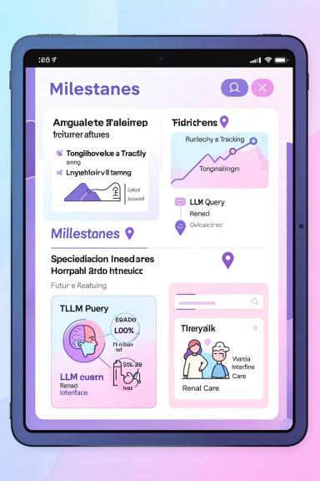
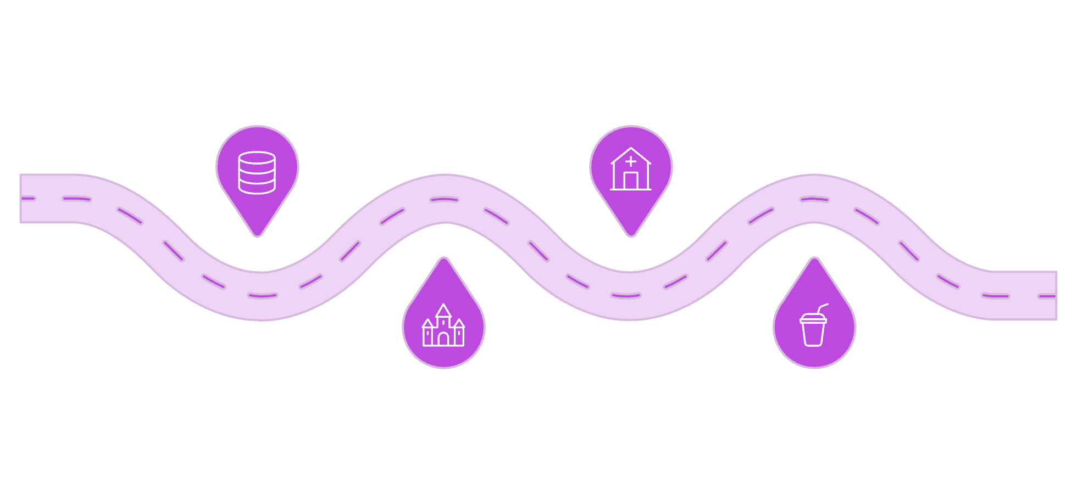
Future Roadmap
Longitudinal DB
Specialized Panels
Integrate Supabase for patient timelines
Add Thyroid, Liver, Kidney views
Ask Your Report
Continuous Learning
LLM-powered natural-language queries
Clinician feedback loop for improvement
Next priorities: longitudinal health tracking, natural‑language querying via integrated LLMs, and specialized analytic panels to broaden clinical coverage.

Slide 10

Conclusion & Impact
We built a production‑ready AI agent that bridges laboratory data and understandable, actionable health guidance — enabling faster interpretation, reduced patient anxiety, and evidence‑driven clinical decisions.
Immediate Value
Long‑Term Vision
Consistent, auditable summaries and prioritized follow‑up recommendations.
Longitudinal monitoring and clinician‑in‑the‑loop continuous improvement.
Thank you — Questions?

